Slide 1
Movie recommender system
Sizhe Chen, Yandi Jin, Miaoran Li, Shuhan Xia, Jing Xu

Slide 2
Problem Description
Problem 1 - Movies
Problem 2 - User
Predicting movie revenue and average rating based on data. What movies tend to get higher vote counts and vote averages? Visualizing key factors making a movie great.
Building recommendation engines based on demographic filtering, content based filtering and collaborative filtering respectively
Technology Needs
Apply machine learning techniques to come up with data-driven solutions and design a user interface to present the results

Slide 3
Dataset Description
movies_metadata.csv: Contains information on 45,000 movies. Features include posters, backdrops, budget, revenue, release dates, languages, production countries and companiesetc.
keywords.csv: Contains the movie plot keywords.
credits.csv: Consists of cast and crew Information.
links.csv: Contains the TMDB and IMDB IDs of all the movies.
ratings.csv: Contains 27,000,000 ratings and 1,100,000 tag applications applied to 58,000 movies by 280,000 users.

Slide 4
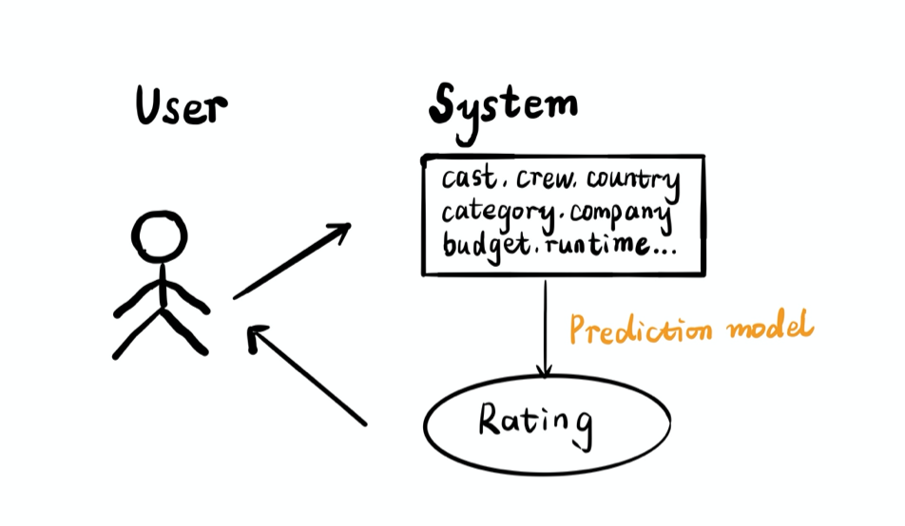
Use Case 1

Slide 5
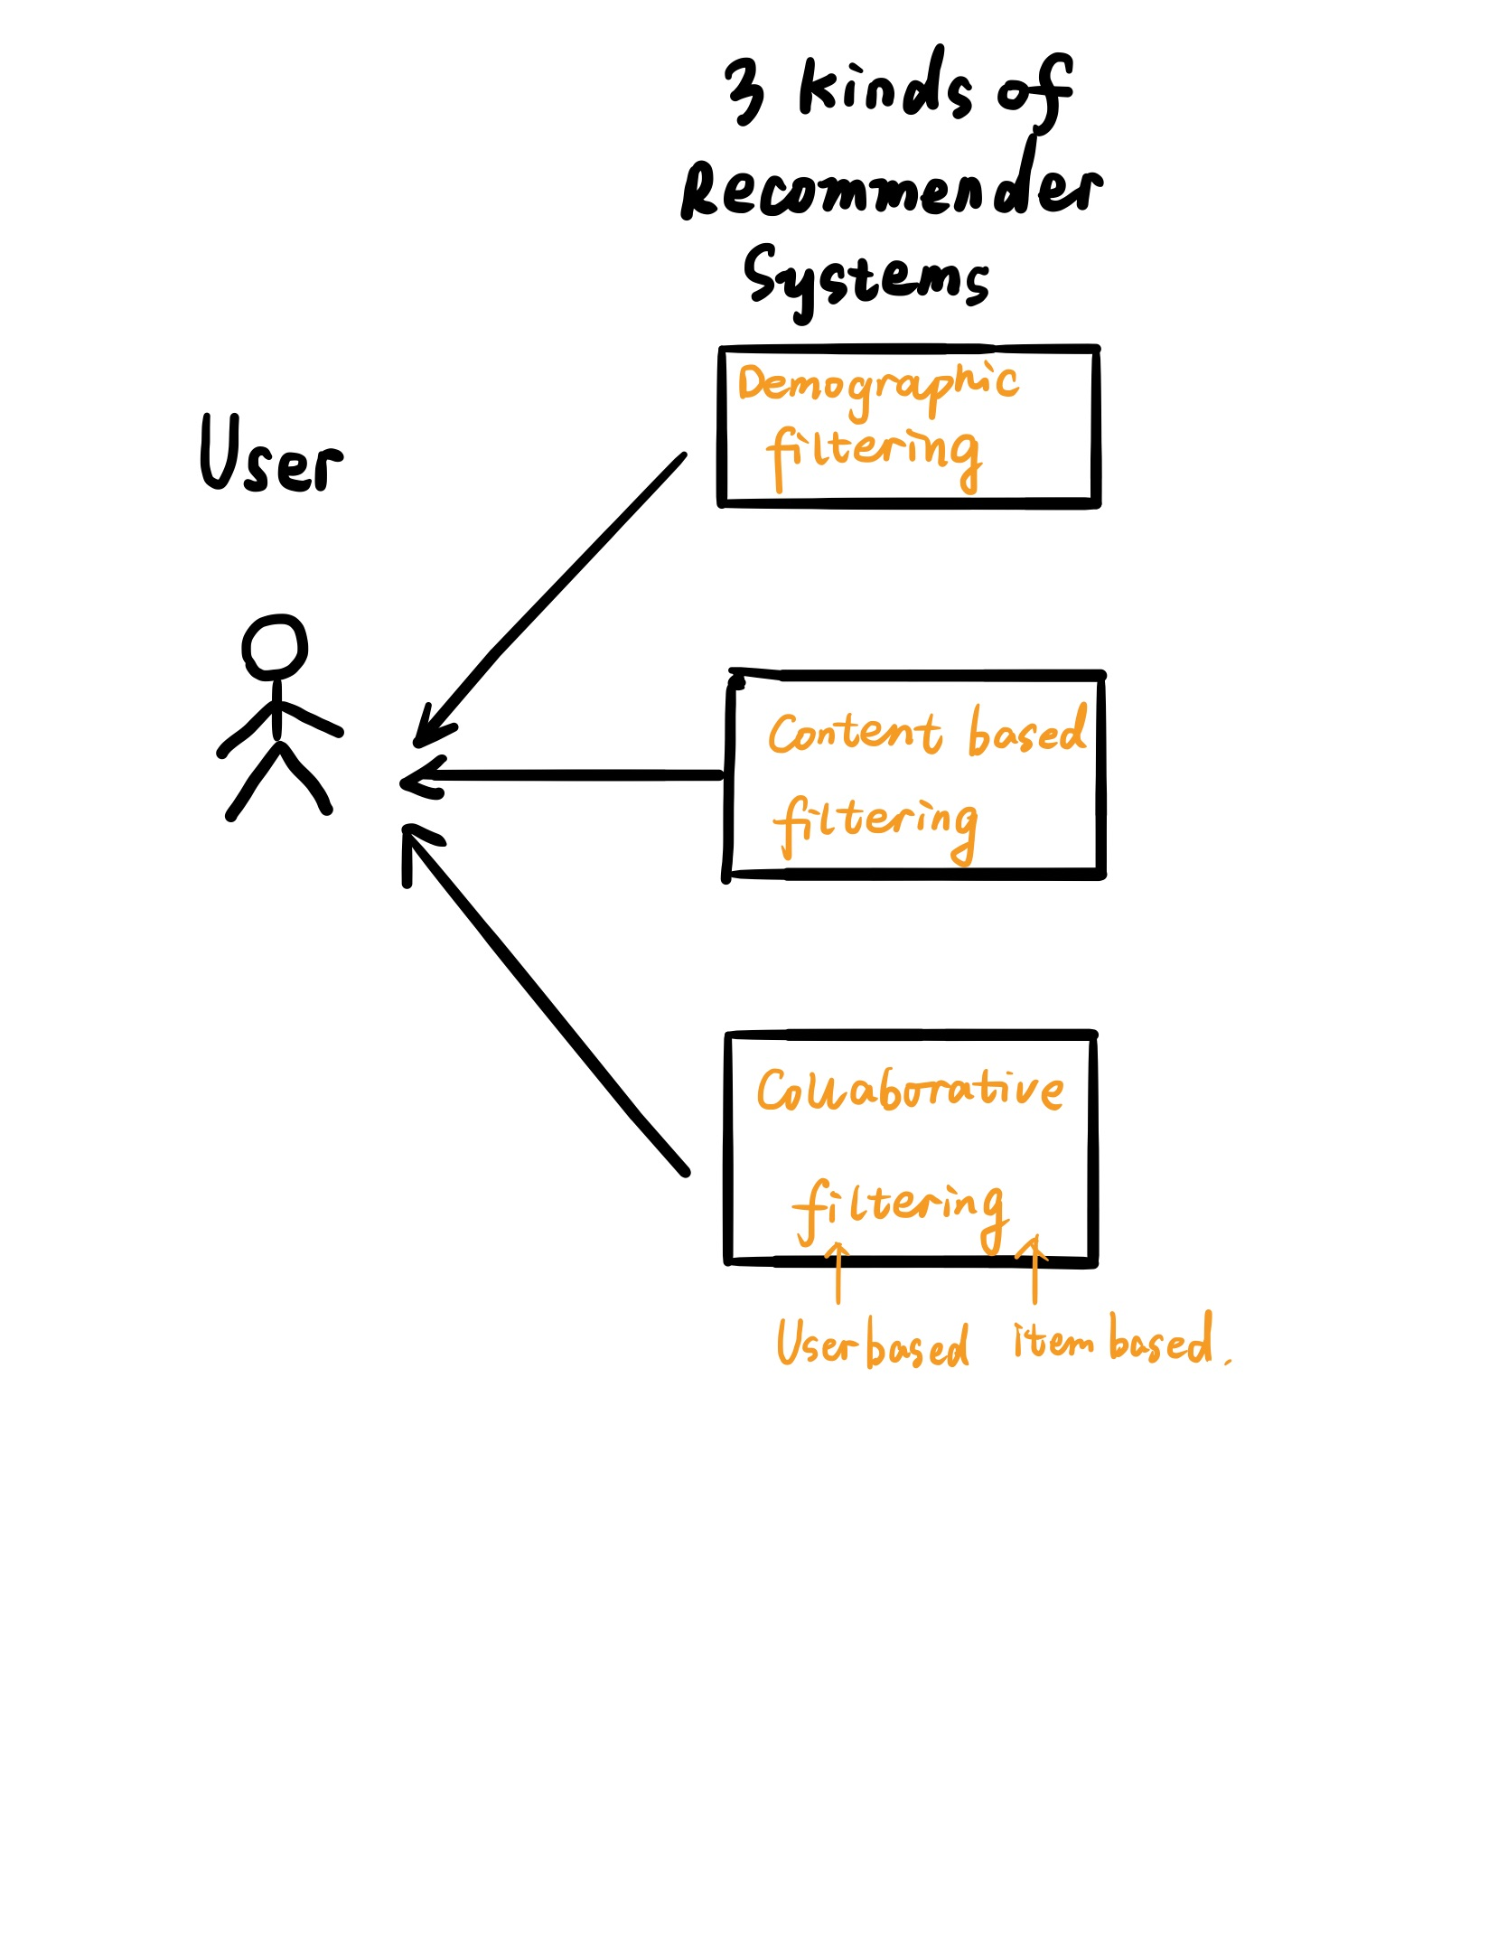
Use Case 2

Slide 6
Library Comparison
Scikit-learn provides fit-transform and predict paradigm to learn from data, transform the data and finally predict. It provides capabilities to prepare classification, regression, clustering and ensemble models. It also provides a multitude of utilities for preprocessing, metrics, model evaluation techniques, etc.
Statsmodels provides a complement to scipy for statistical computations including descriptive statistics and estimation and inference for statistical models.
Scikit-Learn
StatsModels

Slide 7
Library Comparison
Library Comparison
Pros
The go-to package that has it all for classical Machine Learning algorithms
Consistent and easy to understand interface of fit and transform
Capability to prepare pipelines not only helps with rapid prototyping but also quick and reliable deployments
Cons
Inability to utilize categorical data for algorithms out of the box that support such data types (packages in R have such capabilities)
Heavy reliance on the Scipy stack
Scikit-Learn
StatsModels
Pros
Plugs in the gap for regression and time-series algorithms for the python ecosystem
Analogous to certain R-packages, hence smaller learning curve
Huge list of algorithms and utilities to handle regression and time series use-cases
Cons
Not as well documented with examples as sklearn
Certain algorithms are buggy with little to no explanation of parameters

Slide 8
Thanks!

